Slide 1
What can AIGC tools do in a Chemistry Lab
Ai He
2023-06-02

Slide 2
CONTENTS
What's ChatGPT?
Work with ChatGPT
Other GPT-based tools
Making slides

Slide 3
01
What's ChatGPT?

Slide 4
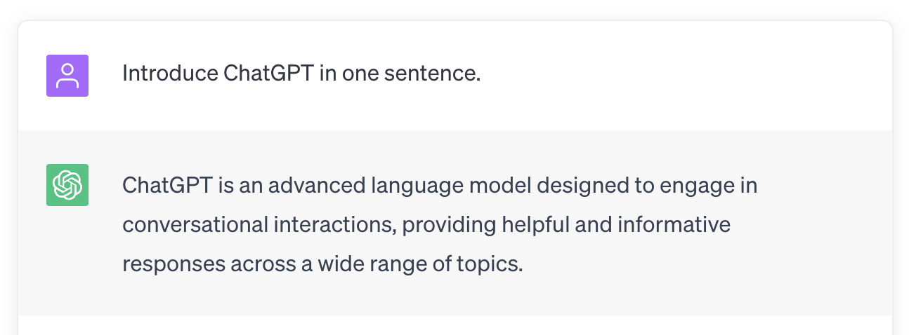
What's ChatGPT?

Slide 5
02
Work with ChatGPT

Slide 6
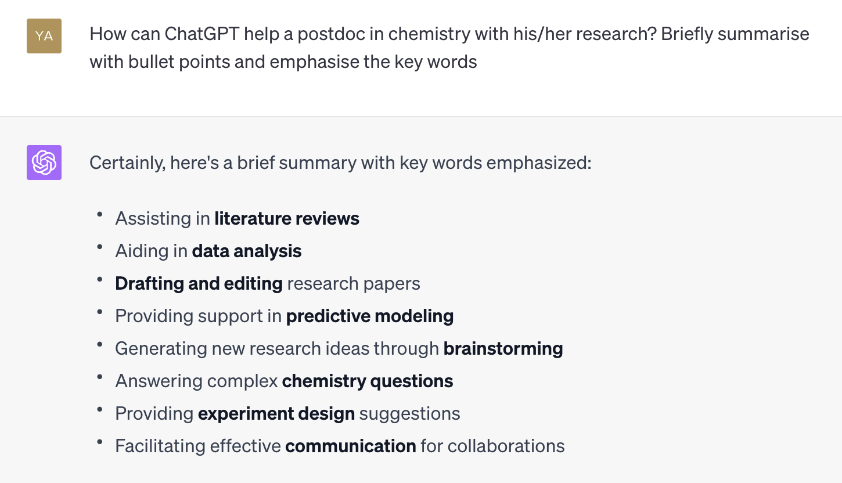
Work with ChatGPT

Slide 7
03
Other GPT-based tools

Slide 8
Other GPT-based tools
New Bing: Help searching and summarising the internet
Github Copilot: Coding assistant
Notion AI: Help to create notes

Slide 9
04
Making slides

Slide 10
Making slides
This presentation is generated by MindShow (https://www.mindshow.fun/), an AI-empowered slides-designing website

Slide 11
THE END
THANKS

